Slide 1
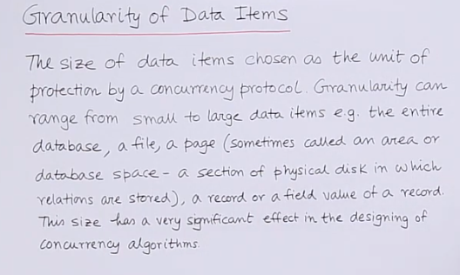
https://www.youtube.com/watch?v=q_-fhQXOQbg

Slide 2
Big Data

Slide 3

https://www.youtube.com/watch?v=bAyrObl7TYE

Slide 4

https://www.ionos.com/digitalguide/websites/web-development/what-is-an-exabyte/

Slide 5
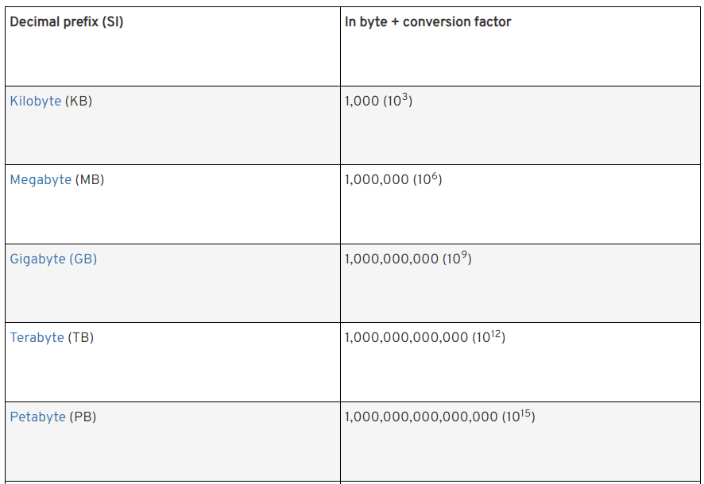
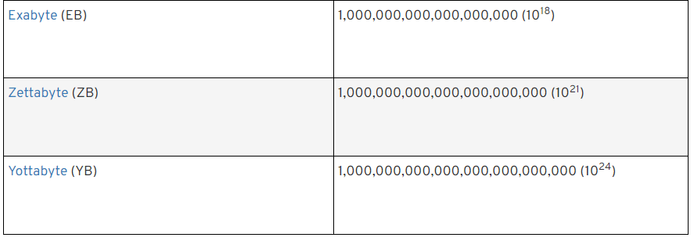
https://www.ionos.com/digitalguide/websites/web-development/what-is-an-exabyte/

Slide 6

https://www.ionos.com/digitalguide/websites/web-development/what-is-an-exabyte/

Slide 7
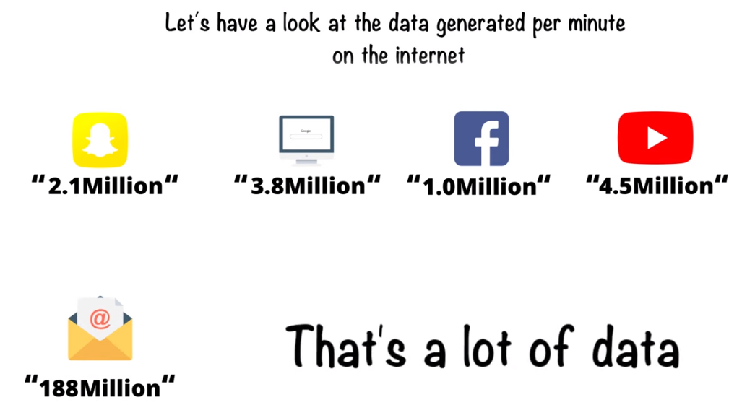

https://www.youtube.com/watch?v=bAyrObl7TYE

Slide 8

https://www.youtube.com/watch?v=bAyrObl7TYE

Slide 9
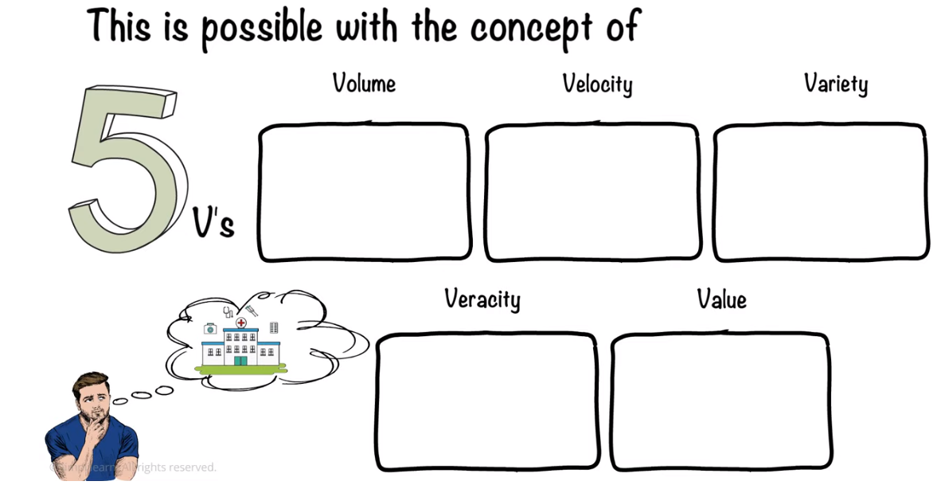
https://www.youtube.com/watch?v=bAyrObl7TYE

Slide 10
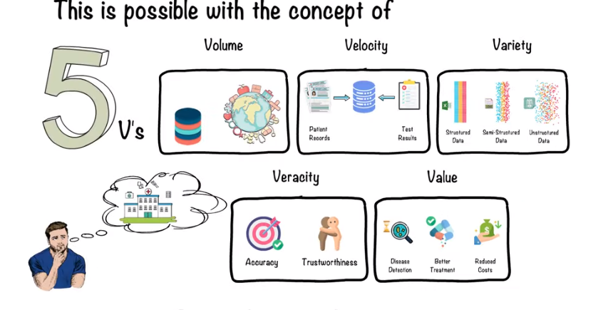
https://www.youtube.com/watch?v=bAyrObl7TYE

Slide 11
Emerging Trends and Applications

Slide 12
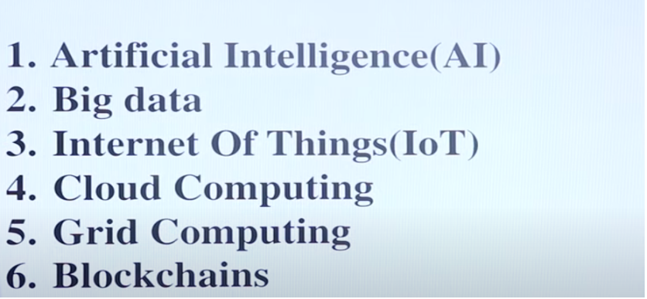
Emerging Trends and Applications
https://www.youtube.com/watch?v=fMVpOPiVmCU

Slide 13
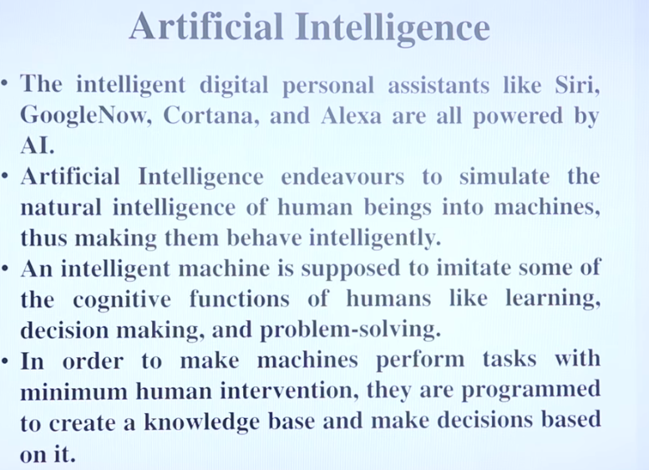
https://www.youtube.com/watch?v=fMVpOPiVmCU

Slide 14
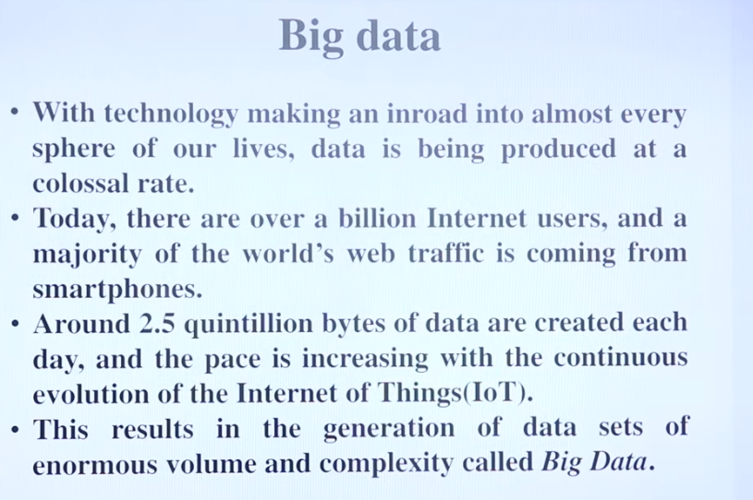
https://www.youtube.com/watch?v=fMVpOPiVmCU

Slide 15
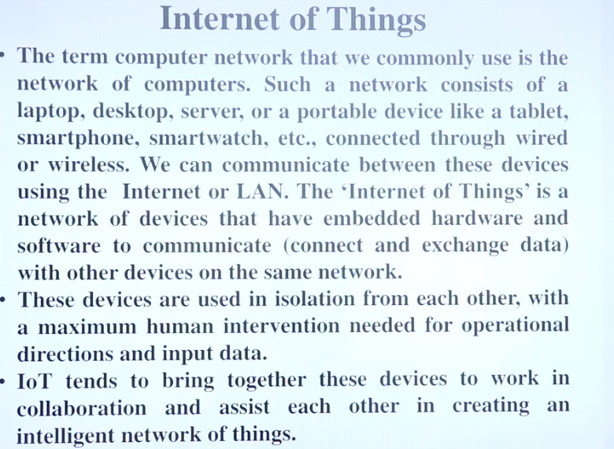
https://www.youtube.com/watch?v=fMVpOPiVmCU

Slide 16
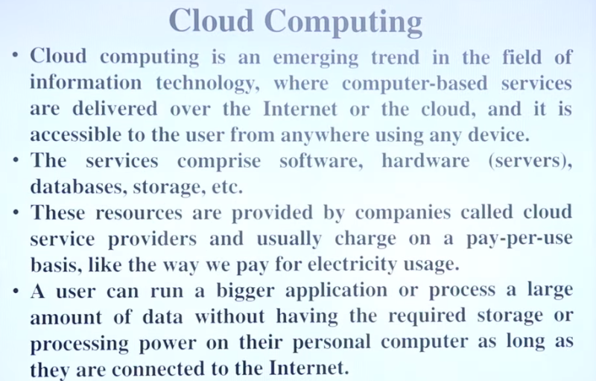
Beside other numerous features, cloud computing offers cost effective on demand resources.
https://www.youtube.com/watch?v=fMVpOPiVmCU

